Slide 1
TAAS
SYSTEM
THERMAL AIDED AIR STERLIZATION
SYSTEM

Slide 2
GROUP MEMBERS
HARSH VISHWAKARMA
SAKSHI PATEL
SARVESH KUMAR MAURYA
JAY PRAKASH KUSHWAHA
DISHABH TIWARI
AMAN SHUKLA

Slide 3
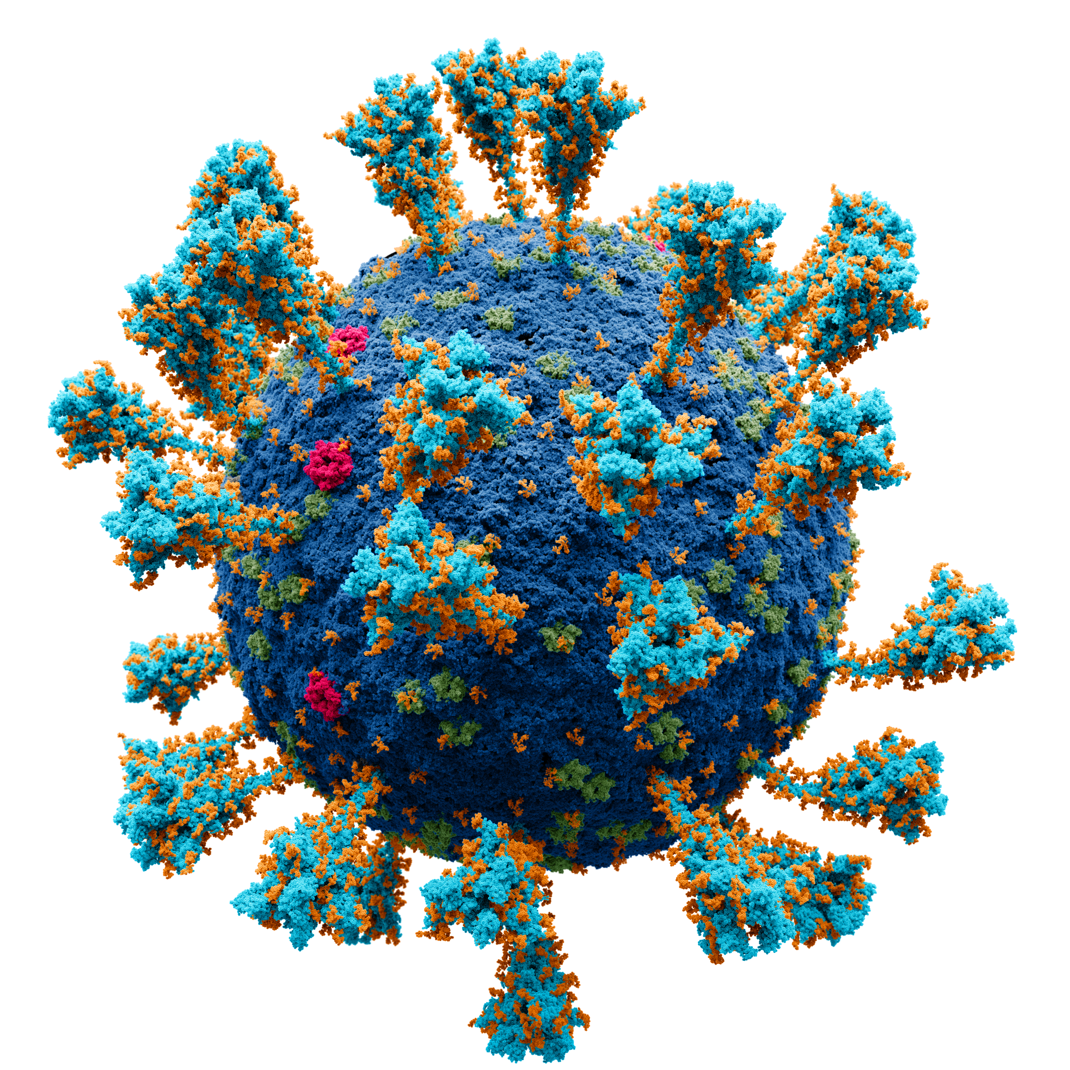

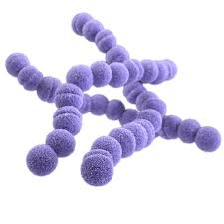
VIRUS AND BACTERIA​:-
PANDEMICS IN WORLD DUE TO VIRUSES AND BACTERIA.​

Slide 4
PANDEMICS OUTBREAKS IN WORLD:-
PANDEMICS :- A Pandemic is an epidemic of an infectious disease that spread across a large region , for instance multiple continents or worldwide ,affecting a substantial number of individuals .​
​
* Throughout human history , there have been a number of pandemics of disease such as SMALLPOX. ​
​
*The most fatal pandemics in recorded history was the black death – also known as THE PLAGUE - WHICH KILLED AN ESTIMATED 75 –200 million people in the 14 century.​

Slide 5
HOW INFECTIOUS DISEASE SPREAD IN HUMANS AND TURN INTO A PANDEMICS:-
* By skin-to-skin contact (handshakes or hugs).​
* By airborne respiratory droplets (coughs or sneezes).​
* By blood products (unclean needles or unscreened blood).​
* By touching a contaminated surface​.

Slide 6
LIST OF INFECTIOUS DISEASE OUTBREAKS ,PANDEMICS AND EPIDEMICS :-​
SMALL POX (1796) :-
It is a serious infectious disease caused by the variola virus. It is contagious—meaning, it spreads from one person to another.​
TEMPERATURE AT WHICH VARIOLA VIRUS WILL BE DEACTIVATE :- 6 HOURS IN AN ATMOSPHERE OF HIGH TEMPERATURE 31 TO 33 DEGREE CELCIUS.​
FLU (INFLUENZA)​1918:-​
The flu pandemic is caused by a new H1N1 flu strain.​
IT IS ALSO CALLED AS SWINE FLU
TEMPERATURE AT WHICH INFLUENZA VIRUS WILL BE DEACTIVATE :- 70 DEGREE CELCIUS . AND ON 40 DEGREE CELCIUS THEY WILL DIE AFTER 12-24 HOURS .​

Slide 7
1955 POLIO :-​
* What temperature kills polio virus:-​
* Several polio epidemics had occurred between 1948 and 1955.​
Polio virus is resistant to inactivation by common laboratory disinfectants such as alcohol. The virus is rapidly destroyed by exposure to temperatures of 50°C or more, autoclaving or incineration.​
Polio, is a disabling and life-threatening disease caused by the poliovirus. The virus spreads from person to person and can infect a person's spinal cord, causing paralysis (can't move parts of the body).​

Slide 8
MEASLES AND RUBELLA:-
1963 MEASLES :-
Measles is an acute viral respiratory illness.
​WHAT TEMPERATURE MEASLES VIRUS CAN BE DEACTIVATE:-
The kinetics of thermal inactivation at 45 degrees C was investigated with different measles virus strains.​
1969 Rubella:-
Rubella is caused by the rubella (roo-BELL-uh) virus (not the same virus that causes measles).
HEAT INACTIVATION:-​
PHYSICAL INACTIVATION: Temperatures exceeding 56 °C for 2-20 minutes, 37°C for 48 hours, or -20 °C will inactivate the Rubella virus.​

Slide 9
(1952-2016)Zika virus:-
Zika virus is most often spread through mosquito bites.
1952:-Zika virus is first reported in a human.​
2007:-Zika virus causes an outbreak on the Yap Islands.​
2013-2014:- Zika virus causes an outbreak in French Polynesia.​
2014-2015:- Zika virus causes an outbreak in Brazil.​
2016:- WHO declares Zika virus to be a public health emergency of international concern​
HEAT INACTIVATION :-​
Temperatures >60°C inactivated the virus​

Slide 10
(2002-2021)SARS and MERS:-
2002-2003:- SARS-CoV
2012:- MERS-CoV
Severe acute respiratory syndrome coronavirus (SARS-CoV), which causes SARS, is found in China. From late 2002 to late 2003, it causes about 8,000 illnesses and 700 deaths. It spreads to 29 countries and then it disappears. Researchers continue to study and develop vaccines for SARS-CoV.
​Severe acute respiratory syndrome (SARS) is a life-threatening disease caused by a novel coronavirus termed SARS-CoV.. The virus was inactivated by ultraviolet light (UV) at 254 nm, heat treatment of 65 °C or greater, alkaline (pH > 12) or acidic (pH < 3) conditions, formalin and glutaraldehyde treatments​
Middle East respiratory syndrome coronavirus (MERS-CoV), which causes MERS, is found in Saudi Arabia. It has caused about 2,500 cases and 800 deaths. Many researchers continue to study and develop vaccines for MERS-CoV.​
Increasing temperature to 65°C had a strong negative effect on viral infectivity as virucidy dropped significantly to 1 minute.​

Slide 11
2020 CORONAVIRUS (COVID-19):-
The virus ‘Severe acute respiratory syndrome coronavirus 2 (SARS-CoV-2)’, the virus that causes COVID-19​.
2019:-A new coronavirus called severe acute respiratory syndrome coronavirus 2 (SARS-CoV-2) is found in China. The SARS-CoV-2 virus causes coronavirus disease 2019 (COVID-19). WHO will declare the COVID-19 outbreak a pandemic in 2020.​
6,718,555 people have died so far from the coronavirus COVID-19 outbreak.
There are currently 669,608,858 confirmed cases in 229 countries and territories . The fatality rate is still being assessed.
In India, from 3 January 2020 to 6:24pm CET, 11 January 2023, there have been 44,680,386 confirmed cases of COVID-19 with 530,722 deaths, reported to WHO. As of 2 January 2023, a total of 2,201,171,934 vaccine doses have been administered.

Slide 12
CORONAVIRUS IN CHINA(COVID-19):-
In December 2019, patients with novel corona virus disease 2019 (COVID-19) emerged in Wuhan, China [1]. The pathogen analysis discovered a new type of coronavirus from infected airway epithelial cells [2], which was named as severe acute respiratory syndrome coronavirus 2 (SARS-CoV-2) [3].
In China, from 3 January 2020 to 6:24pm CET, 11 January 2023, there have been 10,803,226 confirmed cases of COVID-19 with 33,343 deaths, reported to WHO. As of 28 November 2022, a total of 3,465,113,661 vaccine doses have been administered.
China is meeting the Omicron variant with less exposure to the virus and lower vaccination rates among the elderly, public-health experts said.
Dr. Shan-Lu Liu, who studies viruses at Ohio State University, said many existing Omicron variants have been detected in China, including BF.7, which is extremely adept at evading immunity and is believed to be driving the current surge

Slide 13
CURRENT REPORT OF COVID-19 IN CHINA :-
China imposes fresh lockdowns and travel restrictions amid Covid surge
China has detected new Omicron sub-variants BF.7, BA.5.1.7, which are highly infectious
According to local reports, the BF.7 was detected on October 4 in Yantai and Shaoguan city
China lockdown: As China imposes fresh lockdowns and travel restrictions amid Covid surge, the country has detected new Omicron sub-variants BF.7 and BA.5.1.7, which are highly infectious with greater transmissibility.
HEAT INACTIVATION:-
The other SARS-CoV-2 inactivation at 60 °C for 60 min, 92 °C for 15 min, 80 °C for 5 min, and 100 °C for one minute also could be resulted significantly decrease the viral infectivity in a clinical specimen​.

Slide 14
LIST OF VIRUS AND ITS TEMPERATURE OF INACTIVATION:-​
VIRUSES AND BACTERIA | HEAT INACTIAVTION
1 .SMALL POX (VARIOLA VIRUS ) | 6 HOURS IN AN ATMOSPHERE OF HIGH TEMPERATURE 31 TO 33 DEGREE CELCIUS.​
2. INFLUENZA (SWINE FLU)​ | 70 DEGREE CELCIUS . AND ON 40 DEGREE CELCIUS THEY WILL DIE AFTER 12-24 HOURS .​
3. POLIO(POLIOVIRUS)​ | TEEMPERATURE OF 50 DEGREE CELCIUS OR MORE.
4.MEASLES ​ | THERMAL INACTIVATION AT 45 DEGREE CELCIUS.
5.RUBELA​ | Temperatures exceeding 56 °C for 2-20 minutes, 37°C for 48 hours, or -20 °C will inactivate the Rubella virus​.

Slide 15
VIRUSES AND BACTERIA | HEAT INACTIVATION
6. ZIKA VIRUS ​ | Temperatures >60°C inactivated the virus.​
7.NIPAH VIRUS ​ | ------
8. SARS –CoV(CORONA VIRUS) | heat treatment of 65 °C or greater
9. MERS-CoV ​ | Increasing temperature to 65°C ​
10. LUMPY VIRUS ​ | The virus can be inactivated at a temperature of 55°C for 2 hr and 65°C for 30 min​

Slide 16

ABSTRACT
This presentation presents a technological idea related to air sterilization.
In the present era, it requires technology to combat the various viruses which spread very quickly in atmosphere and harms us.
There are various viruses which can be deactivated from heat waves.
This project will work as both air sterilization and air filter.
Notes:
Notes to presenter:
Description of what you learned in your own words on one side.
Include information about the topic
Details about the topic will also be helpful here.
Tell the story of your learning experience. Just like a story there should always be a beginning, middle and an end.
On the other side, you can add a graphic that provides evidence of what you learned.
Feel free to use more than one slide to reflect upon your process. It also helps to add some video of your process.

Slide 17

What we are trying to make ?
Our prototype will be based on compactness for easy transportation and high efficiency for high prevention.
4
Air filter with UV rays sterilisation.
The prototype will contain some chambers which are as follows :
3
Cooling system.
2
CHAMBER-1 : Air filter with UV rays sterilisation.
Thermal air sterilisation.
1
CHAMBER-2 : Thermal air sterilisation.
Air filter with UV rays sterilisation.
CHAMBER-3 : Cooling system.
CHAMBER-4 : Air filter with UV rays sterilisation.
Notes:
Notes to presenter:
What steps will you be taking as a result of this learning experience?
Did you learn from any failed experiences? How will you do things differently?
What advice will you give to others so they can learn from your experiences?
How can you share what you learned with a real-world audience?
Some examples of next steps might be:
After delivering my first persuasive presentation, I am thinking about joining the debate team.
After making my first film, I’m considering entering it in our school film festival or local film festival.
After connecting with this career expert, I’d like to do some research on that career field because it sounds interesting to me.
This SmartArt allows you add images and text to help outline your process. If a picture is worth a thousand words, then pictures and words should help you communicate this reflection on learning perfectly! You can always click on Insert>SmartArt to change this graphic or select the graphic and click on the Design contextual menu to change the colors.
Feel free to use more than one slide to share your next steps. It also helps to add some video content to explain your message.

Slide 18
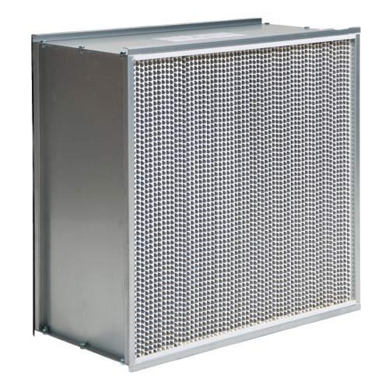
CHAMBER 1 & 4 (FILTERATION)
This chamber consist of layers of filters which initially encounter all the dust and virus particle from inlet.
We will initially stop dust particle and viruses which cannot pass through filters
This chamber will also consist of ultra violet rays system
Ultra Violet will deactivate virus which get stuck on filters.
HEPA FILTER

Slide 19
SOME IMPORTANT PARTS
FILTERS:-
There are a number of technologies emerging to sterilize air. For purification of air, HEPA filter (high efficiency particulate air filter) are widely used in the wall mounted devices. It is not a sterilizing process but only a filtration process where the particles less than 0.2µm are only allowed to pass through the HEPA filter. Therefore, the virus are not de-activated by HEPA filter.
Another widely used means of sterilization is ultra- violet light. There are many commercial air sterilizers based on this technology.

Slide 20
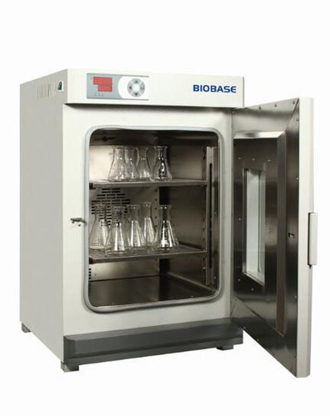
CHAMBER 2 (THERMAL STERLIZER)
This is our main part and this chamber is thermally activated chamber in which filtered air will come along with virus
In this chamber we are going to deactivate the viruses present in air.
Due to high temperature of chamber the air inside chamber will also gets heated up and this eventually destroy protein layer of virus which finally kills virus
There are many method of increasing temperature in this chamber which again can be controlled by electronic method from outside.
THERMAL STERLIZER
OVEN

Slide 21
HEATING METHOD:-
Air heating can be achieved through the following methods:
Convection air heating:- Convection air heating utilize gas burners for heating air by recirculating it internally. In gas-fired equipment, gas is filled into the burner and heat from the burner is distributed homogeneously by using a fan throughout the unit. Convection air heating is the most common method for air heating since the heat produced can be easily controlled.
b) Infrared heating:- Infrared heating utilize radiation energy emerging from light emitter panels of various wavelengths based on intensity of heating. Sheathed elements or quartz can be used to make infrared panels.
c) Induction heating:- electromagnetism is used in induction heating to heat a conductive component. It is accomplished by passing an electric current via an induction coil which produces an electromagnetic field. In that field, when iron or steel components are placed, resistance in the flow of electricity is introduced. Consequently, creation of energy and heat takes place in the process.

Slide 22
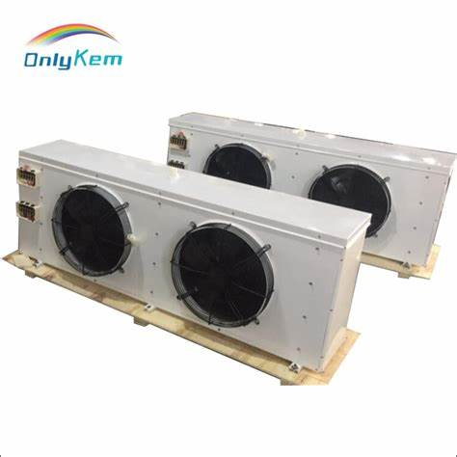
CHAMBER 3 (COOLING)
This is again an important part of our project “cooling chamber”
Here in this chamber we will reduce temperature of hot air by sustainable method.
This is more important because no one need air warmed up to very high temperature so we have to reduce temperature.
We can also upgrade this system to a air refigration system later
COOLING FAN

Slide 23
Virus Name | Size of that virus | Temperature at which virus become inactive
Lumpy Virus (Doesn’t affect Humans) | - | 55°C for 2 hours, 65°C for 30 minutes.
Nipah Virus | 40 – 600 nm in diameter | -
Influenza (Swine flu) | 80 – 120 nm in diameter | On 40°C , they will die after 12 – 24 hours.
SARS-COV-2 (Corona Virus) | 20 – 50 nm in diameter | 55°C for 20 minutes, 70°C for 5 minutes.
Zika Virus | Approximately 50 nm in diameter | >60C for 5 minutes.

Slide 24
PRESENT AND FUTURE SIGNIFICANCE
So far now , you all may have understood that our idea is a topic of discussion.
As per todays scenario many type of viruses are spreading all over world and we need a solution which can reach in every home, so this project is affordable and futuristic alternative.
There are many places where we can use it, as, of course hospitals, cars, ambulance, hotel-rooms and much more.

Slide 25
Our project is not only limited to sterilize air in a closed room, but we can use the concept and can build machine on same principle with varying construction to facilitate different working environment.
De-pyrogenation process can also be made much more efficient by using thermal air sterilisation (a pyrogen is a substance which causes fever).

Slide 26
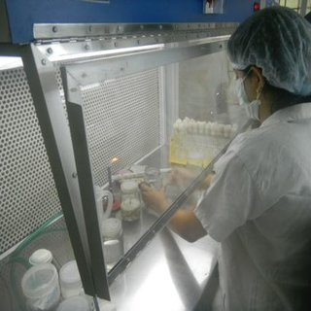
In the Pharmaceutical industry and Biotechnology research labs, products based on our idea can be employed.
In case of any outbreak in lab or in any emergency
condition, thermal air steriliser will be very helpful
and effective.

Slide 27
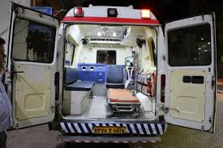
There are many places where we can use it, as, of course hospitals, cars, ambulance, hotel-rooms and much more.
Inside ambulances and in cars, we can
install this device so that spreading of viruses
can be resisted and controlled.

Slide 28
ENGINEERS NEVER FAILS, THEY LEARN AND GIVE THERE BEST..
REFRENCE :-
INDIAN ENGINEERING CONGRESS (35TH EDITION)
THROUG INTERNET
THANK YOU..

